Slide 1
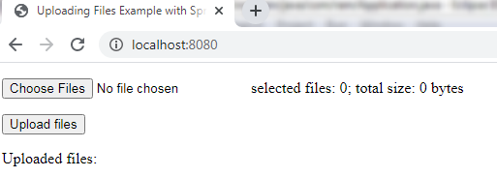
Spring Boot File Upload Example with MultipartFile
Will See how to upload multiple files in Spring Boot with MultipartFile

Slide 2
https://hellokoding.com/uploading-multiple-files-example-with-spring-boot/

